Slide 1

Mapping the Customer Journey: Predicting Purchase Conversion through Behavioral Analytics
Presented by Emily Picinich
Notes:
Hello everyone, my name is Emily Picinich, and today I’ll be presenting my project titled Mapping the Customer Journey: Predicting Purchase Conversion through Behavioral Analytics. This project explores how customer behavior data from an e-commerce platform can be used to predict who is most likely to make a purchase, and how those insights can guide better business decisions.

Slide 2
The Problem
E-commerce sites attract thousands of visitors daily, but most never make a purchase.
Understanding why users drop off, and identifying what drives purchases, is critical.
This project aims to answer one central question: Which customer behaviors most accurately predict a purchase?
Notes:
Every e-commerce site faces the same challenge: lots of people visit, but only a small portion actually buy something. Understanding what makes one visitor convert while another leaves the site is one of the most important questions in online retail. So the goal of this project was to uncover which customer actions best predict a purchase, and how businesses can use that knowledge to improve conversion rates.

Slide 3
Why It Matters
Every missed purchase is a lost opportunity.
If companies can recognize high-intent users early in their journey, they can:
Personalize offers and recommendations.
Reduce cart abandonment.
Focus marketing dollars where they have the most impact.
Notes:
From a business perspective, predicting purchase behavior matters because every abandoned cart represents lost revenue. If we can identify high-intent users early, companies can tailor their approach, maybe offering a discount, a reminder email, or a personalized recommendation, and recover potential sales. In short, the better we understand customer behavior, the smarter we can be with marketing and website design.

Slide 4
The Data
Dataset: Customer Journey – Click to Conversion (Kaggle, 2025)
12,719 sessions
10 variables capturing user behavior.
Key fields include:
PageType: Home, Product, Cart, Checkout, Confirmation
DeviceType: Desktop, Mobile, Tablet
ReferralSource: Google, Email, Social Media, Direct
ItemsInCart and TimeOnPage_seconds
Purchased: 1 (Yes), 0 (No)
The data was clean, balanced across countries, and ready for modeling.
Notes:
This project used a dataset called customer_journey.csv, which contained over 12,000 user sessions and 10 key features describing customer behavior. It included things like the page a user visited, their device type, country, referral source, how long they spent on the page, how many items they added to their cart, and whether or not they made a purchase. The data was clean and well-balanced across devices and regions, making it a solid foundation for analysis and predictive modeling.

Slide 5
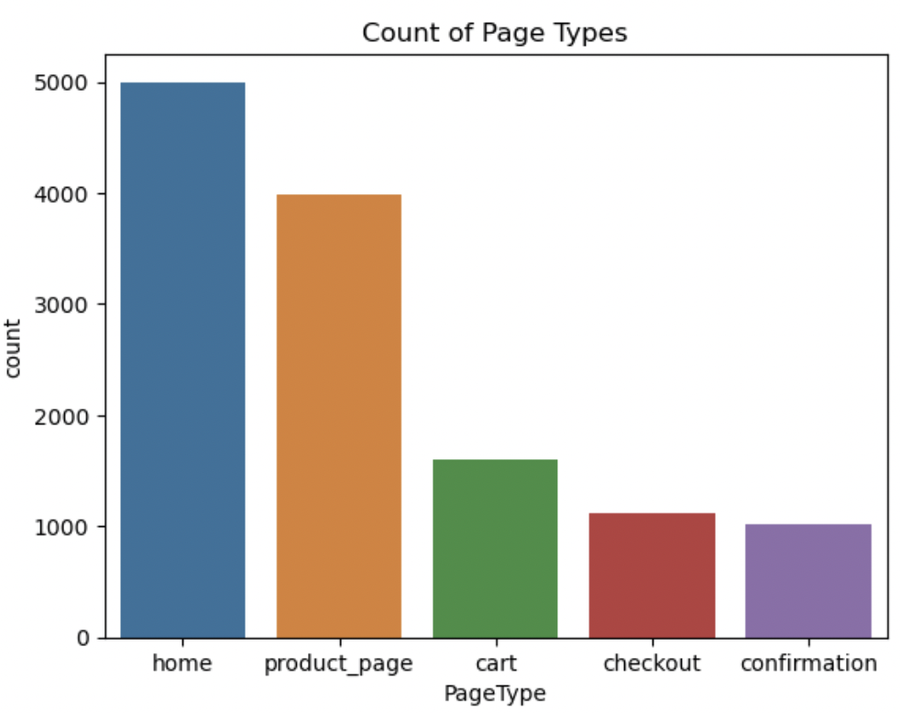
The Customer Funnel
Most users begin on home and product pages, but only a small fraction reach checkout or confirmation.
This funnel drop-off is the biggest barrier to conversions, as each stage loses potential buyers.
Notes:
When we look at how users move through the website, we see a clear funnel. Most people start on the home or product page, but as they move closer to checkout, the number of visitors drops off sharply. This drop-off is one of the biggest challenges for e-commerce businesses: understanding where customers disengage can help teams redesign pages or simplify steps to reduce that friction.

Slide 6
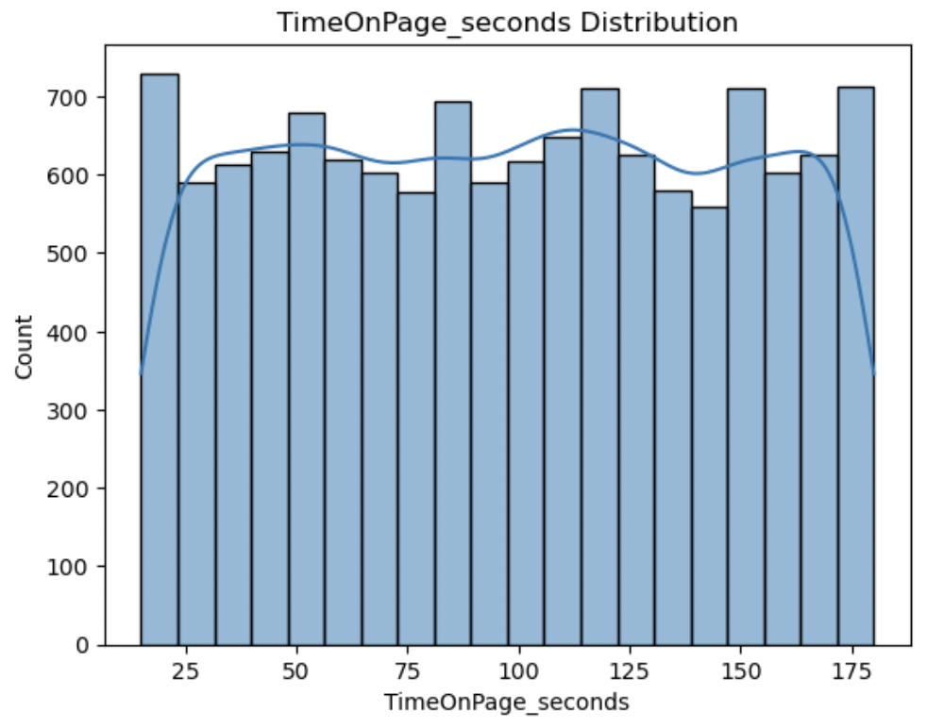
How Long Do People Stay?
Time on page varied widely, with no dominant peak.
This suggests that length of visit alone does not predict purchases.
Some shoppers buy quickly, others browse for a while without buying.
Notes:
One of the first things I looked at was how long people spend on the site. The data showed that there’s no consistent pattern. Some customers purchase after just a few seconds, while others browse for a long time without buying. This tells us that time on page isn’t necessarily a good predictor of purchase behavior. A long visit doesn’t always mean interest; sometimes it means indecision.

Slide 7
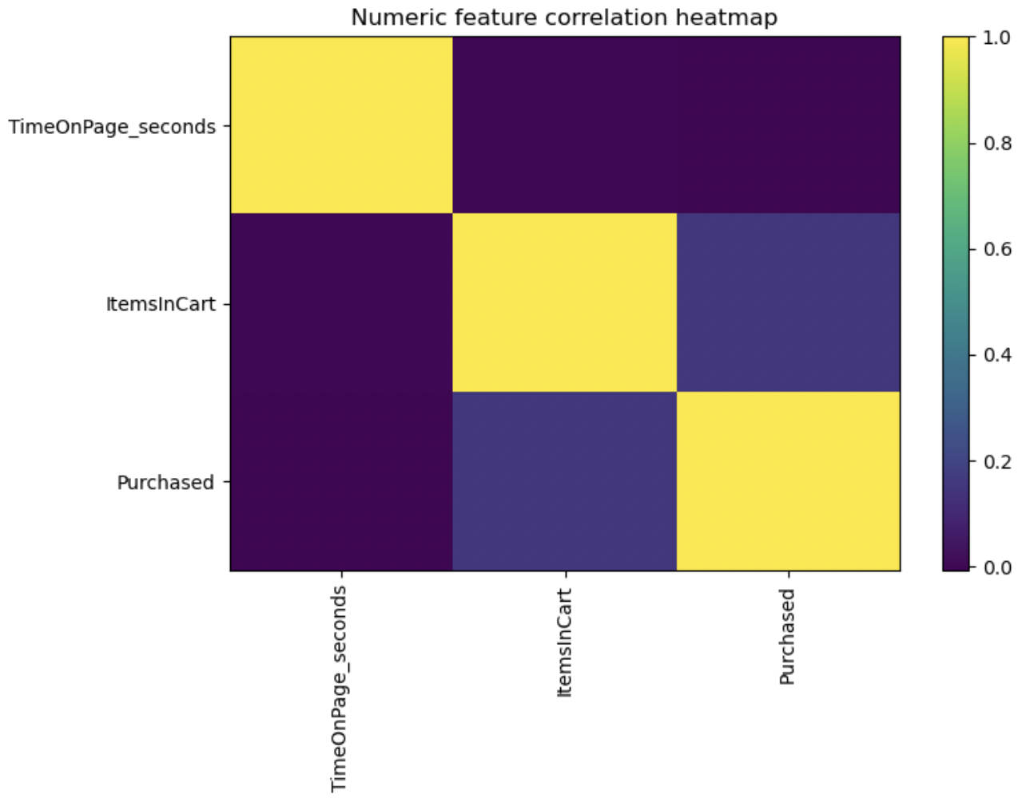
Key Behavior Indicator
Adding items to the cart turned out to be the strongest signal of buying intent.
Correlation: r = 0.155, p < 0.001
Even a small increase in items added significantly increased purchase likelihood.
Conclusion: Getting users to add something to their cart is the first major commitment point.
Notes:
Next, I analyzed the number of items customers added to their carts. This was the first strong indicator of conversion. The more items a customer added, the higher the chance they would complete a purchase. Even though the correlation wasn’t huge, it was statistically significant, meaning that getting customers to add anything to their cart is a major step toward conversion. This insight could help businesses focus on early engagement strategies, like “Add to Cart” pop-ups or bundle offers.

Slide 8
What Else Matters?
A statistical test (Cramer’s V) showed:
PageType had the strongest relationship with purchases
V = 0.576, p < 0.001
Country and ReferralSource showed weak but significant effects
DeviceType had no meaningful relationship
Interpretation: The deeper a user travels into a site, especially to checkout or confirmation, the more likely they are to convert.
Notes:
To understand which other factors influenced purchase behavior, I ran a statistical test called Cramér’s V. The results showed that the type of page a user visited was the most important factor by far. Users who reached checkout or confirmation pages were much more likely to purchase than those who stayed on the home or product pages. In contrast, device type had no impact at all, meaning mobile, tablet, and desktop users behaved similarly. This reinforces that where a customer is in their journey matters more than how they got there.

Slide 9
Predictive Modeling
2 models were built to predict purchase likelihood:
Random Forest – more complex but less accurate.
Logistic Regression – simpler, faster, and more interpretable.
Performance:
Accuracy: 86.9%
ROC-AUC: 0.959
F1-Score: 0.82
The Logistic Regression model correctly identified the majority of actual buyers.
Notes:
After the exploration, I built two predictive models: a Random Forest and a Logistic Regression model. The Logistic Regression model performed better overall, achieving almost 87% accuracy and an AUC score of 0.96, which means it could distinguish purchasers from non-purchasers about 96% of the time. This model is also easy to interpret, making it ideal for business applications. It can quickly highlight which actions are most strongly tied to buying behavior.

Slide 10
What We Learned
Adding items to a cart is the strongest predictor of purchase.
Time on page doesn’t matter. Engagement depth matters more than duration.
Checkout progression (PageType) is the key behavior to track.
A simple, interpretable model can predict conversions with high accuracy.
Notes:
From this project, several key takeaways stood out. First, adding items to the cart is the strongest behavioral signal of intent. Second, time on page doesn’t matter much. Engagement depth is more meaningful than duration. Third, the checkout journey, represented by page type, is the clearest indicator of purchase likelihood. And finally, a simple model like Logistic Regression can produce powerful, actionable insights without unnecessary complexity.

Slide 11
Business Takeaways
To increase conversions:
Encourage users to add to their cart early (reminders, small discounts, etc.).
Simplify the checkout flow – remove friction between product view and purchase.
Focus on high-intent users at later funnel stages with personalized offers.
Monitor funnel drop-off metrics regularly and optimize weak touchpoints.
Notes:
So what can businesses actually do with this information? They can redesign their funnels to encourage small early commitments, like adding one item to the cart. They can streamline the checkout process to reduce drop-offs. And they can target customers who are already deep in the funnel with personalized messages or limited-time offers, focusing their marketing on those most likely to buy. These data-driven strategies can directly boost conversion rates and improve the customer experience.

Slide 12
Future Uses
This model could evolve to:
Predict churn or subscription renewals.
Personalize recommendations based on engagement patterns.
Integrate into real-time marketing dashboards for smarter decision-making.
Ethical note: All data is anonymized and used responsibly to enhance, not exploit, the customer experience.
Notes:
Looking ahead, this model can be expanded in exciting ways. It could be used to predict other key outcomes like customer churn, subscription renewals, or even lifetime value. It could also feed into a live dashboard that scores users in real time, helping marketing teams make on-the-spot decisions. Of course, ethical use is crucial. All predictions should be transparent, anonymized, and focused on helping customers, not manipulating them.

Slide 13
Closing
This project demonstrates how data-driven behavioral insights can transform e-commerce strategy.
By understanding where users engage and where they drop off, businesses can bridge the gap between browsing and buying.
Key takeaway: The more personalized and frictionless the journey, the more likely a customer is to convert.
Notes:
In conclusion, this project showed that data science can provide real, actionable insight into the customer journey. By understanding what behaviors lead to a purchase, businesses can tailor their strategies to better serve customers and increase sales. Ultimately, this data analysis isn’t just about predicting numbers – it’s about understanding people and creating experiences that meet their needs. Thank you for listening, and I’m happy to take any questions.

